Slide 1
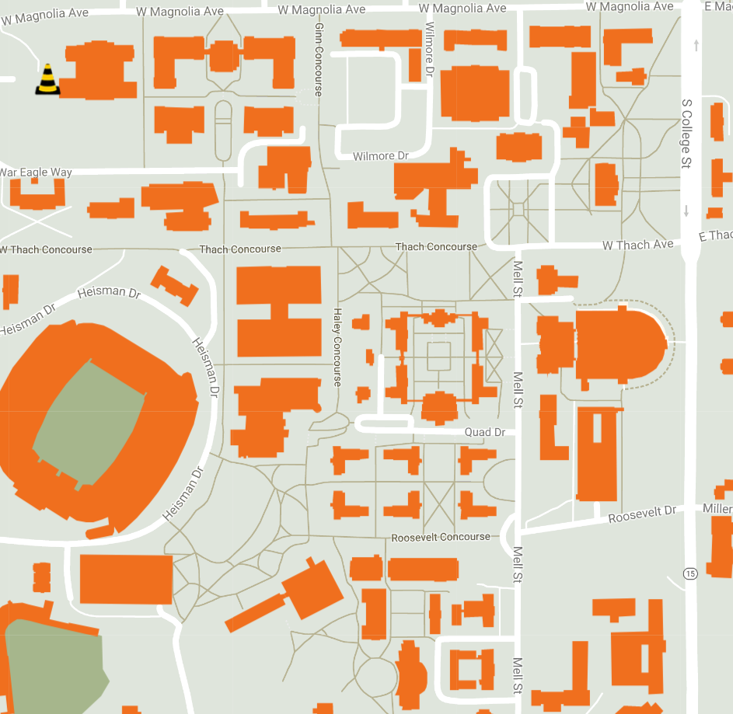
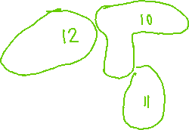
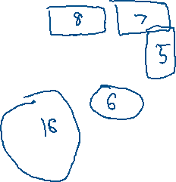

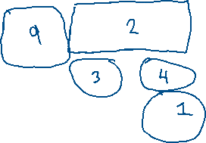

Where to Post SPARC Flyers:
Engineering/Business (No Approval Required)
Broun
Shelby
Wiggins
WERL
Davis
Ross
Harbert
Ramsey
Lowder
COSAM (No Approval Required)
Chemistry Building
Science Center
Parker/Allison
Haley Center
General Buildings (Approval may be Required)
Mell/RBD
Student Center
Foy
Future Buildings (once completed)
Gavin
Student Achievement Center
Leech Physics Building
Graduate Business Building

